Slide 1

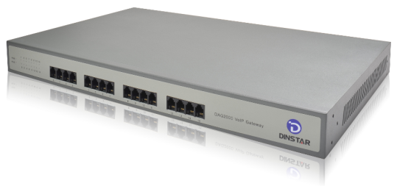
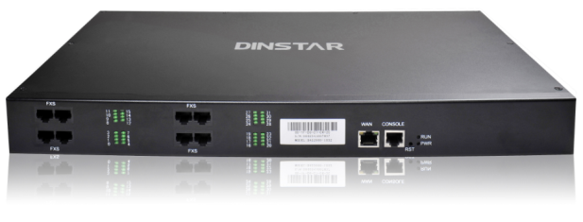

DAG2000 Series VoIP Access Gateway
Overview
DAG2000 series voice gateway is a VoIP access gateway based on IP. It is able to provide quality voice service for carrier, enterprise, Village users and company. Supported standard SIP protocol and compatible mainstream IPPBX and softswitch platform.
Product pictures
DAG2000-16S
DAG2000-32S
Key benefits
Primary and secondary SIP account
Flexible set port group
IP trunk
Flexible routing and manipulation
Data/ Voice/ Management VLAN
Voice /FAX/Modem
Traffic Shaping
Firmware update automatically /configure update
The Gateway to VoIP World

Slide 2

Decade focused
Creates the high-quality goods
Physical Interfaces
Protocol
Phone ports: 16/24/32FXS, RJ-11
Ethernet Interfaces:
16FXS: 4*RJ-45 10/100Mbps, RJ-45
24FXS: 4* RJ-45 10/100Mbps, RJ-45
32FXS: 4* RJ-45 10/100Mbps, RJ-45
SIP V2.0 (RFC 3261,3262,3264)
SDP (RFC 2327)
REFER (RFC 3515)
RTP/RTCP (RFC 1889,1890)
STUN (RFC 3489)
ARP/RARP (RFC 826/903)
SNTP (RFC 2030)
DHCP/PPPoE
TFTP/HTTP/HTTPS
DNS/DNS SRV (RFC 1706/RFC 2782)
VLAN 802.1P/802.1Q
Voice & FAX
G.711A/U law, G.723.1, G.729A/B
Comfort Noise Generation(CNG)
Voice Activity Detection(VAD)
Echo Cancellation(G.168)
Adaptive (Dynamic) Jitter Buffer
Hook flash test
Programmable Gain Control
T.38/Pass-through/Modem FAX mode,
Up to 14.4kbps
DTMF mode: Signal/RFC2833/INBAND
Supplement Service
Call waiting
Call transfer(Blind transfer, Attend Transfer , Half blind transfer)
Quick pick
Call forwarding
Hotline
Call hold
DND
3-way conference（1/2/4FXS Support）
Voice mail
Direct IP address call
Private Service
Inquire LAN port IP *158#
Inquire WAN port IP *159#
Get IP address *150*
Restart*111#
Factory reset*166*000000#
The Gateway to VoIP World

Slide 3

Customer first
Services more intimately
Call & Route
Maintain & Upgrade
Port group
IP trunk
Primary and secondary SIP account
32 inbound routing
32 outbound routing
Number manipulation
Dial plan set
Web based configuration
Telnet configuration
Data backup/restore
Support English and Chinese language
Firmware upgrade by TFTP
Syslog and CDR
Web & telnet login password modify
Factory reset
Automatic time synchronization
SNMP
IVR local maintenance management
Network Feature
NAT (Rout and Bridge)
Static IP, PPPoE, DHCP
DHCP server
IP,TCP, UDP,TFTP, FTP, TCP,ARP,RARP, Ping, NTP, SNTP, Http, DNS, Trancert
Static/dynamic ARP
Dimension & Weight:
16FXS:442(L)*280(W)*44(H)mm 3.0kg
24FXS:442(L)*250(W)*44(H)mm 3.5kg
32FXS:442(L)*250(W)*44(H)mm 3.5kg
Environment
Power input:100-240VAC,50-60Hz
Power consumption: 24FXS:80W;
32FXS:100W
temperature(operator): 0 ℃ ~ 45 ℃
(storage): -20 ℃ ~80 ℃
Humidity: 10%-90% no condensation
Packing Content
Gateway
Power adapter
RJ-45 Network cable
User’s Manual CD
Authentication
CE, FCC
The Gateway to VoIP World

Slide 4

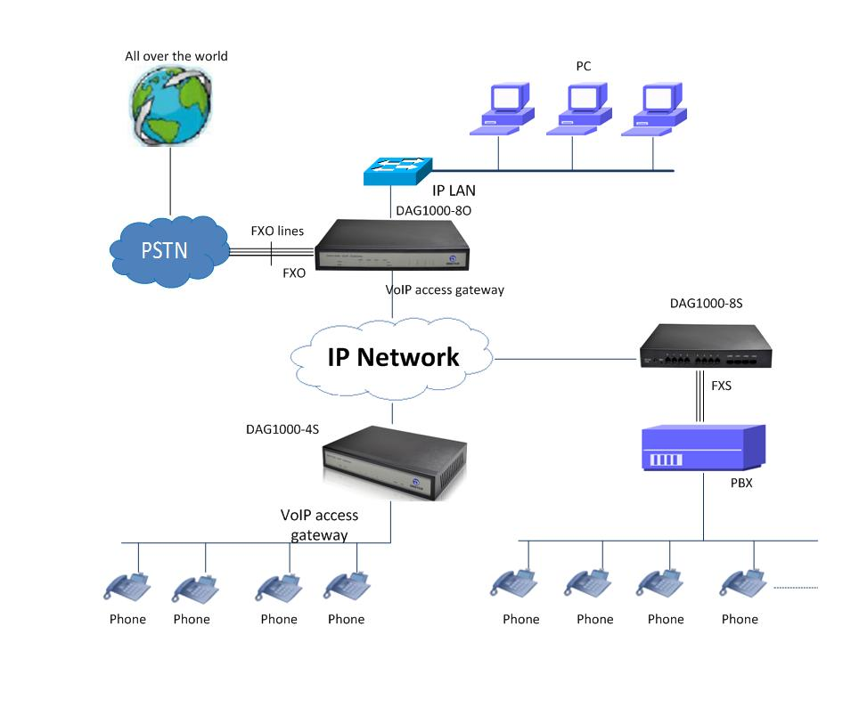

Trust Growth Cooperation Sharing
System Application
Dinstar Technologies Co., Ltd.
The Gateway to VoIP World

